Slide 1
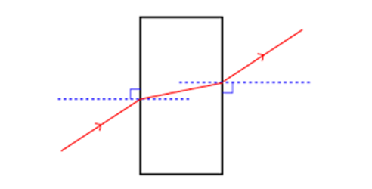
Daily Review
Refraction
When light rays enter a denser material, such as water from air, the light slows down and is bent towards the normal.
What happens to light rays when they pass from a more dense material into a less dense material?
Why does the light bend this way?

Slide 2
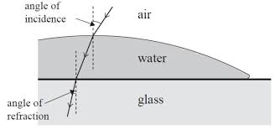
Skill Development/Guided Practice
CFU 2
Is the light going to slow down or speed up?
CFU 1
What are the refractive indices of air and glass?
Describing Refraction
Identify the refractive indices of the substances. State the change in refractive index: high to low / low to high Explain what happens to the speed of the light and which way it bends. Light slows down = bends towards normal Light speeds up = bends away form normal
Explain what happens to light as it passes from air into water.
Substance | Refractive Index
Air | 1.00
Water | 1.33
Perspex | 1.49
Glass | 1.53
Diamond | 2.42
Light is passing from a medium with a _____ refractive index to one with a _____ refractive index.
The light will _____ and bend _____ from the normal.

Slide 3
Skill Development/Guided Practice
CFU 2
Is the light going to slow down or speed up?
CFU 1
What are the refractive indices of air and glass?
Describing Refraction
Identify the refractive indices of the substances. State the change in refractive index: high to low / low to high Explain what happens to the speed of the light and which way it bends. Light slows down = bends towards normal Light speeds up = bends away form normal
Explain what happens to light as it passes from glass into water.
Substance | Refractive Index
Air | 1.00
Water | 1.33
Perspex | 1.49
Glass | 1.53
Diamond | 2.42
Light is passing from a medium with a _____ refractive index to one with a _____ refractive index.
The light will _____ and bend _____ from the normal.

Slide 4
Applications of Refraction Year 9 Physics

Slide 5
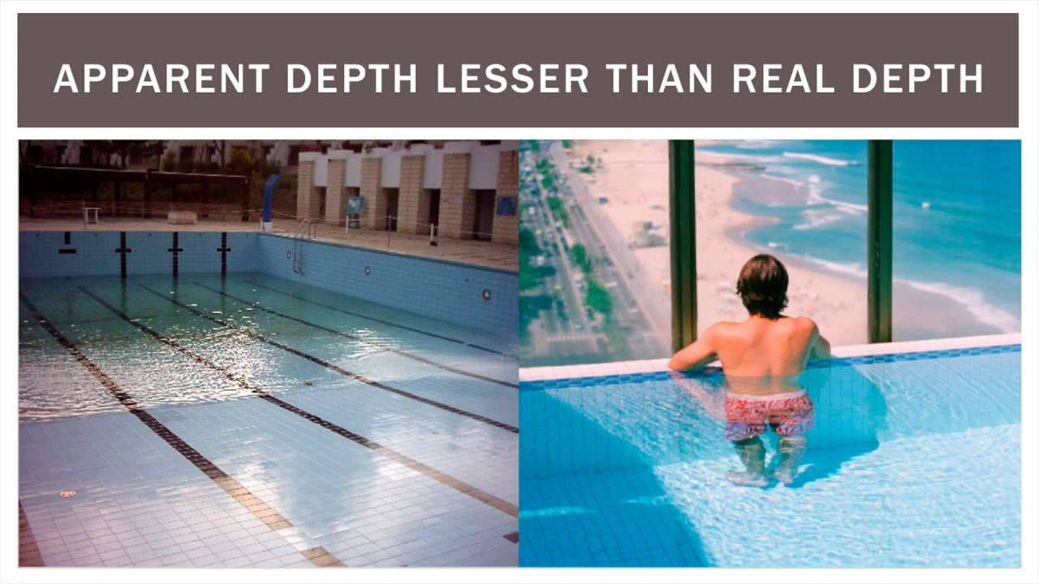
Learning Objectives
CFU
What are we going to learn?
Use refraction to explain apparent depth and mirages.
Explain total internal reflection and describe some of its uses.
Activate Prior Knowledge
Think, pair, share: When you stand on the edge of a swimming pool or a pond, what do you notice about the depth of the objects you see, compared to the actual depth of the body of water?

Slide 6
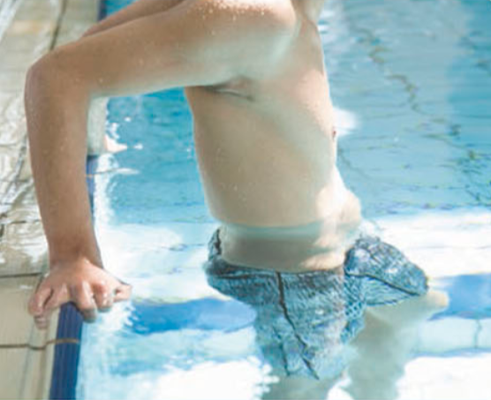

Concept Development
Depth Illusions
When someone stands in a swimming pool, their legs look shorter than normal.
Rocks on the bottom of a stream look like they are in shallower water than they actually are.
Depth illusions occur because light reflecting off an object under water refracts as it leaves the water surface and moves into air.

Slide 7
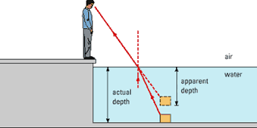
Concept Development
CFU 1
Why does water have a higher refractive index than air?
Depth Illusions
Light reflects off underwater objects and moves from water, into air and to our eyes.
Water is more dense than air, so has a higher refractive index.
Light is bent away from the normal when it leaves the water.
CFU 2
What happens to light as it leaves the water?

Slide 8
Concept Development
CFU 1
How does our brain interpret light?
Depth Illusions
Our brain interprets light as moving in straight lines.
When the refracted light reaches your eyes, your brain traces the light rays back in a straight line.
This makes the object appear closer to the surface.
CFU 2
Why does the object appear closer to the surface?

Slide 9
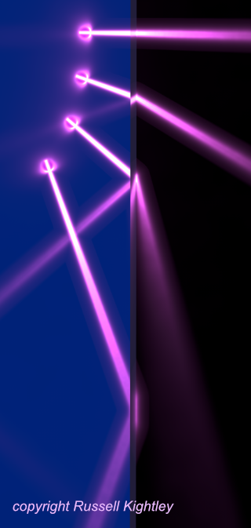
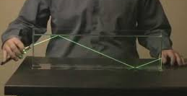
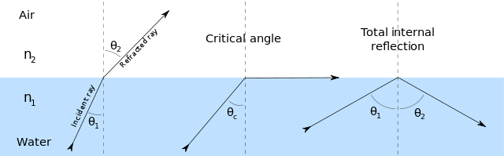
Concept Development
CFU 1
What is the critical angle?
CFU 2
When does total internal reflection occur?
Total Internal Reflection
When light travels from water or glass into air, some light is reflected and some is refracted.
This is why you can see your reflection in windows.
When the angle of incidence is increases, it reaches a critical angle where the light is refracted along the surface.
Any angle of incidence bigger than this will cause the light to be reflected inside the object.

Slide 10
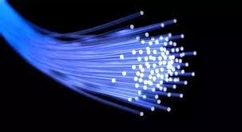
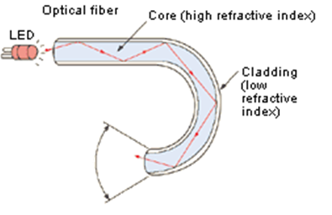
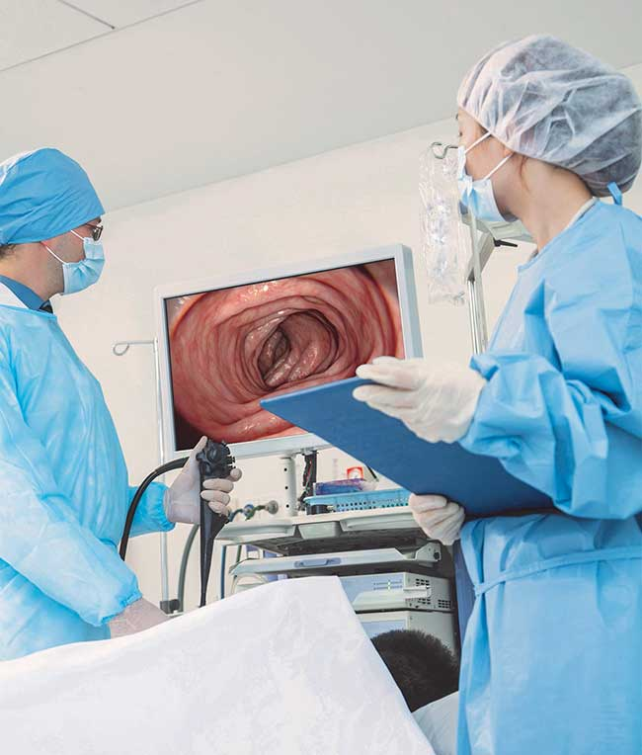
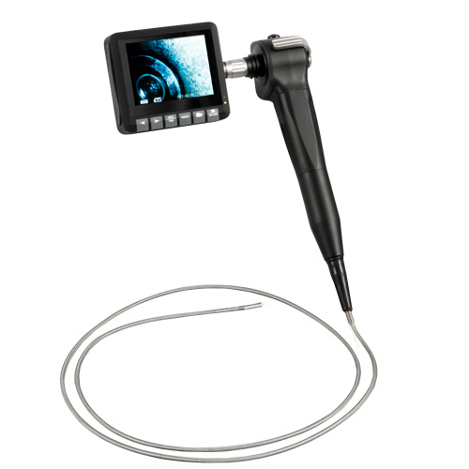
Concept Development
CFU 1
How is an optical fibre made?
Optical Fibres
Narrow fibres of glass or plastic, with a special coating.
When light is shone in one end, it is totally internally reflected.
The light moves through the fibre until it reaches the other end.
Optical fibres are often used in surgery.
A small cut is made and an optical fibre is inserted.
A computer screen shows what can be seen at the end of the optical fibre.
CFU 2
What happens to light when is shone into the fibre?
CFU 3
Explain one use of an optical fibre.

Slide 11
Skill Development/Guided Practice
Using Refraction to Explain Phenomena
Draw a simple diagram of the situation. Show the path of the any real light rays. If applicable, add any imaginary light rays. Explain what has happened in the situation.
Take out your Science book or a piece of paper from your Science file.
Rule up your page and give it the title:
Using Refraction to Explain Depth Illusions and Optical Fibres
Divide you page in half. In the top half write the subheading Depth Illusions. In the bottom half write the subheading Optical Fibres.
For the two situations on the following slides, draw a diagram and explain what is happening.

Slide 12

Skill Development/Guided Practice
Using Refraction to Explain Phenomena
Draw a simple diagram of the situation. Show the path of the any real light rays. If applicable, add any imaginary light rays. Explain what has happened in the situation.
Explain why the fish appears to be at a different depth when a person looks at a fish from a jetty.
The light reflecting off the fish is refracted when it leaves the water.
Our brain traces the light rays back in a straight line, so the fish appears closer to the surface than it actually is.

Slide 13
Skill Development/Guided Practice
Using Refraction to Explain Phenomena
Draw a simple diagram of the situation. Show the path of the any real light rays. If applicable, add any imaginary light rays. Explain what has happened in the situation.
Explain how light is transmitted through an optical fibre.
An optical fibre is made from a thin piece of glass or plastic covered in a material with a low refractive index.
Light shone into one end of the fibre is internally reflected down the fibre until it reaches the other end.
Optical fibres are used in medicine, home theatres and communication systems.

Slide 14
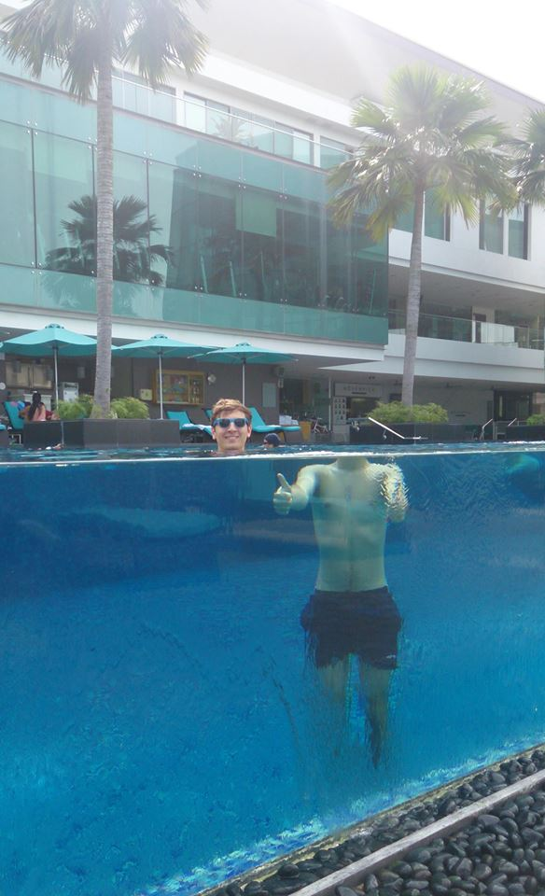
Relevance
Knowing about how the speed of light changes in different materials will help you understand how light is bent, or refracts, when it passes through different substances.
Understanding how light refracts will help you explain how depth illusions occur and how optical fibres are used to transmit light.

Slide 15
Skill Closure
Why do objects on the bottom of a pool appear closer than they actually are?
Skill Closure
Name two situations where optical fibres are commonly used.
Skill Closure
Draw a simple diagram to show how light is internally reflected in an optical fibre.

